Slide 1

Epidemiology Simulation of COVID-19:
Understanding the Spread
of a Global Pandemic
Team 3: Spenser Cheung, Tushar Goel, Christopher Magana, and Steven Nguyen
Notes:
Chris

Slide 2
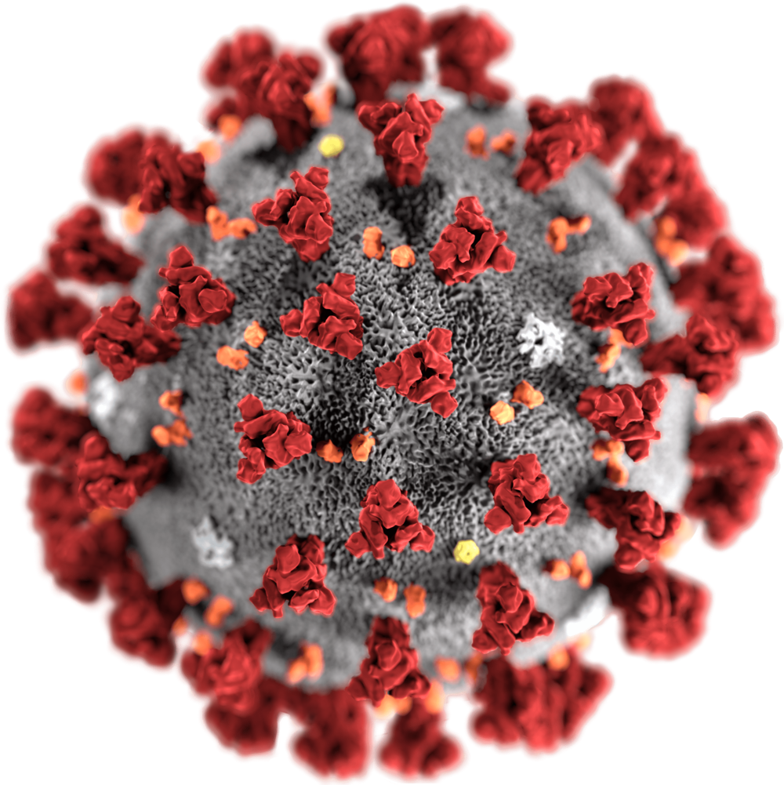
COVID-19
Latest + Unique virus
Seizes control of genes differently than known viruses
Pandemic
Limited quantity of vaccines
Notes:
Chris

Slide 3
The World’s Tricky Challenge
Replicate the impact of COVID-19 on a population
Predict the end of COVID-19
Based off different policies and events (e.g. social distancing + vaccinations)
Notes:
Chris

Slide 4
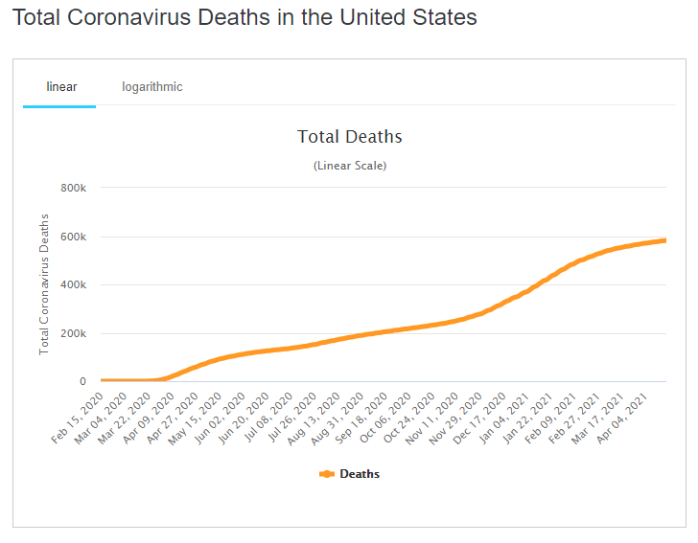
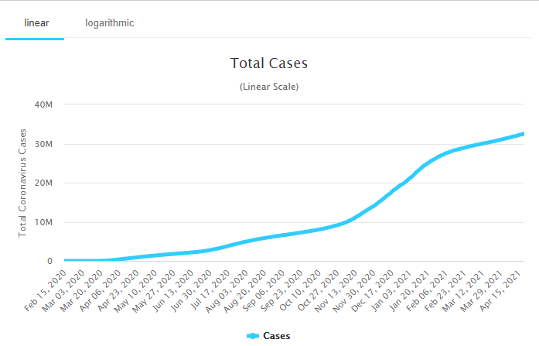
Current State of the Country
United States. (n.d.). Retrieved April 22, 2021, from https://www.worldometers.info/coronavirus/country/us/

Slide 5
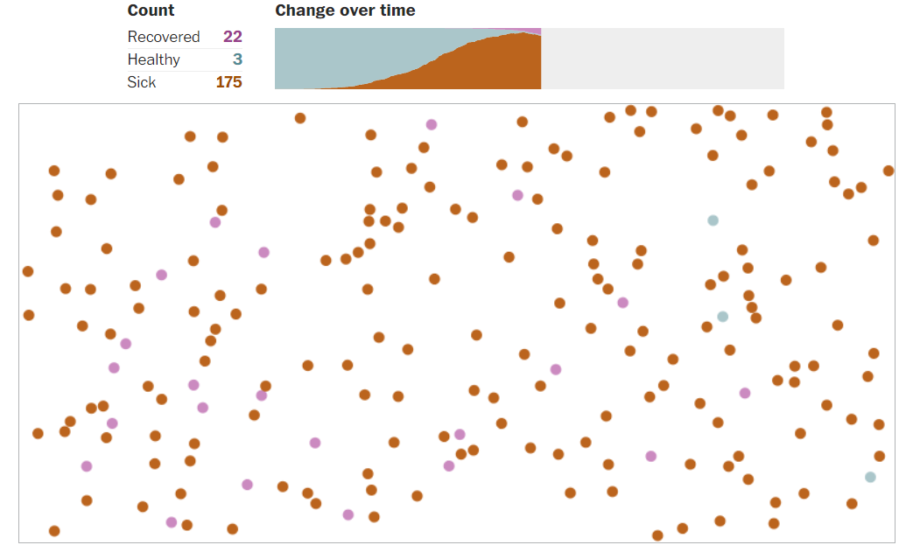
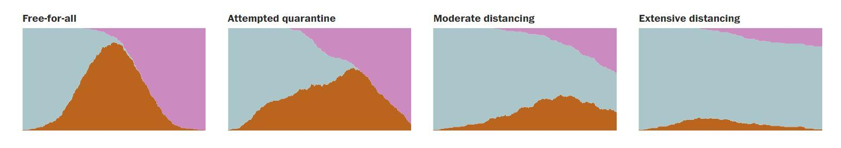
Similar Simulation:
Posted: March 14th, 2020
Population: 200
Goal: Show methods of how to “flatten the curve”
United States. (n.d.). Retrieved April 22, 2021, from https://www.washingtonpost.com/graphics/2020/world/corona-simulator/
Notes:
Spenser Start
Attempted quarantine = replicate forced quarantine by Chinese Goverment on Hubei province (aka GROUND ZERO for COVID-19)
Moderate distancing = 75% of population adopt social distancing
Extensive distancing = 1 out of every 8 people can move AKA 7 out of 8 people social distancing

Slide 6
Our Model’s Parameters
Random Variants:
Recovery Time
Vaccination Time
Node Movement
Static Variants:
Death Rate
Infection Rate
Population

Slide 7
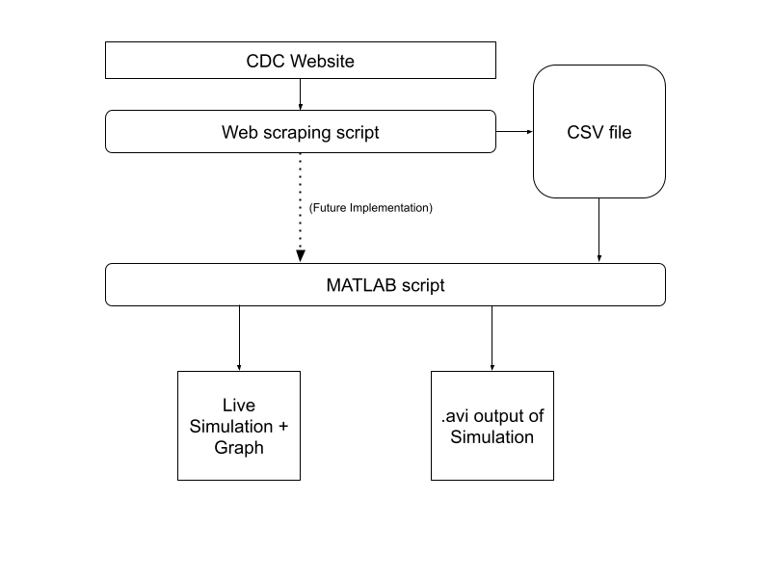
Pipeline
Python script
Grabs data from CDC Data Tracker status bar
Calculates statistics
Writes grabbed + calculated data to CSV file
MATLAB script
Uses CSV file to set simulation parameter(s)
Runs + displays simulation
Notes:
Spenser

Slide 8
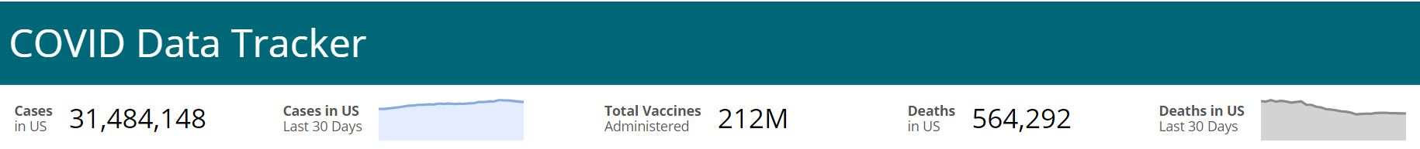
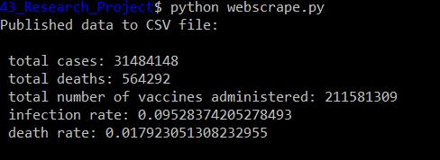
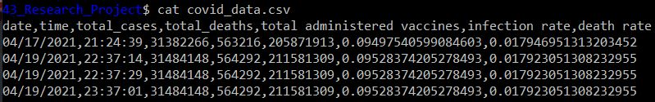
Web Scraping
GET request using CDC’s API
Calculate average infection rate and death rate
Option: infection rate/day (implemented but not used)
Notes:
Spenser End

Slide 9
Simulation Overview
Variable Initialization
COVID-19
Vaccination
Population
Collision Checks
Map Boundary
Node
Status Checks
Susceptible → Vaccinated
Susceptible → Infected
Infected → Recovered
Infected → Deceased
Plotting
Notes:
Tushar Begin

Slide 10
Simulation Functionality
A series of vectors are used to continually update the current status of each node. Specifically:
Current Status
Time until status change (if susceptible / infected)
Current Position & Movement
In effect, as time progresses, we can keep track of how nodes act and whether a discrete event, such as a collision occurs.
In the case of a collision, we consider how each node changes after the interaction based on each node’s previous status and movement.

Slide 11
Activity Flow Diagram
Computation Start
Collision Computation
Infected Individual Check
Susceptibility Check
Simulation Plotting and Video Creation
Notes:
After the first computation iteration is done i.e. all the checks as shown in the activity flow diagram is performed, the simulation plotting starts and it continues till the end of the computation. Also video is being with each snapshot of the simulation

Slide 12
Activity Flow Diagram (contd.)
Computation Start
Collision Computation (Explained on next slide)
Susceptibility Check
Infected Individual Check
Vaccination Time Check
Decrement the recovery time
No
Recovery Time Check
Decrement the vaccination time.
No
Yes
Mortality Check
Yes
Update state to vaccinated
Update state to recovered
No
Yes
Update state to dead and immobile

Slide 13
Activity Flow Diagram (contd.)
Collision Computation
No status change
Check for preventing collision with themselves
No
Infected check
Collision Occurs
Mobility check
Yes
Transmission Check
No
Create Virtual Wall
Yes
No status change
No
Yes
Both nodes are infected
Compute new move speed and direction of movement
Update the position

Slide 14
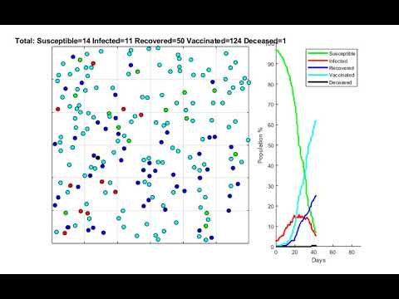
Simulation
Notes:
Tushar End

Slide 15
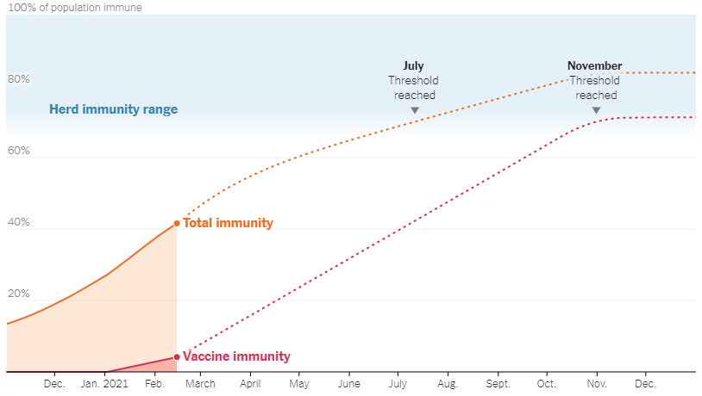
Restatement of Goals
Main objective: Predict the end of the COVID-19 pandemic.
Achieved when herd immunity reaches 60 - 70%.
Covid is determined to be over when herd immunity is reached.
United States. (n.d.). Retrieved April 22, 2021, from https://www.nytimes.com/interactive/2021/02/20/us/us-herd-immunity-covid.html
Notes:
Steven Begin

Slide 16
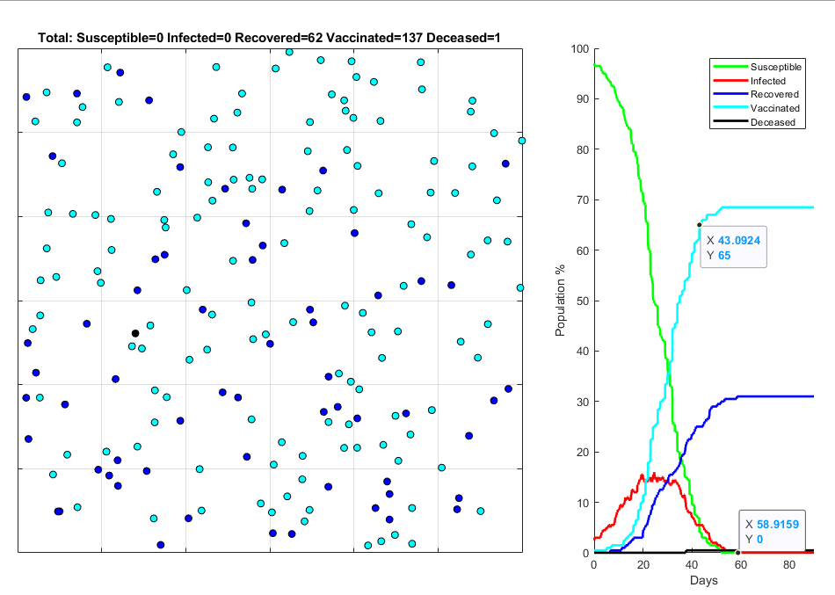
Results
Using April 19, 2021 data:
Social distancing = 40%
Transmission rate = 40%
Mortality rate = 1.7%
Recovery time = 15 ± 5 days
Vaccine time = 30 ± 10 days
Achieved Herd Immunity at ~43 days
COVID-19 dies out at ~59 days

Slide 17
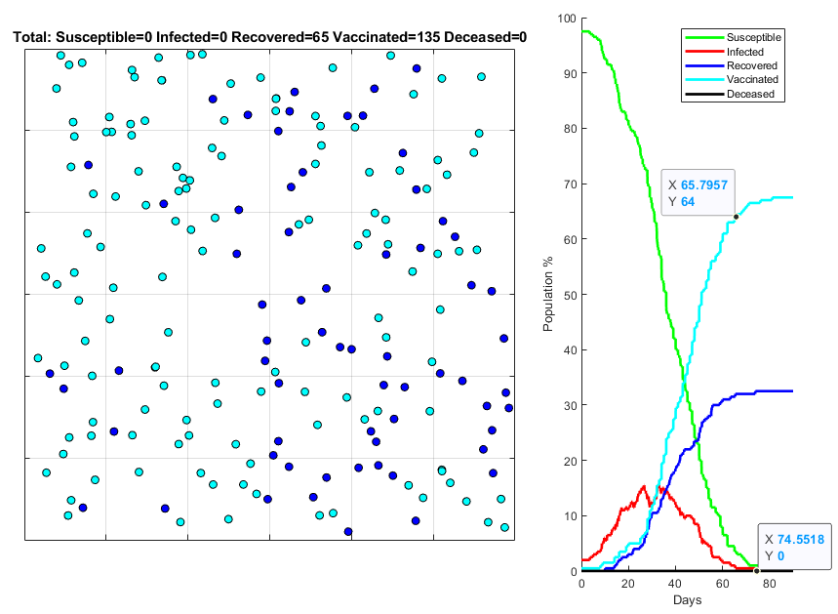
Results (contd.)
Achieved Herd Immunity at ~65 days
Using April 19, 2021 data:
Social distancing = 40%
Transmission rate = 40%
Mortality rate = 1.7%
Recovery time = 15 ± 5 days
Vaccine time = 45 ± 15 days
COVID-19 dies out at ~74 days

Slide 18
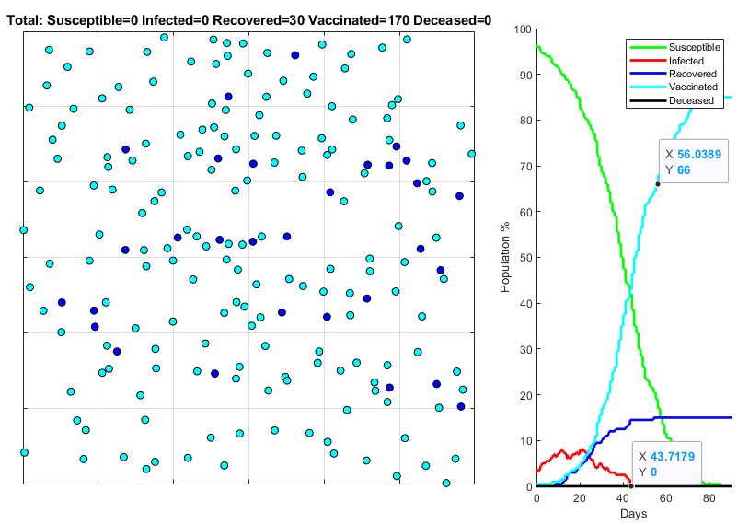
Results (contd.)
Using April 19, 2021 data:
Social distancing = 60%
Transmission rate = 40%
Mortality rate = 1.7%
Recovery time = 15 ± 5 days
Vaccine time = 45 ± 15 days
Achieved Herd Immunity at ~56 days
COVID-19 dies out at ~44 days

Slide 19
Limitations
Consistent vaccination rate
In reality, this may fluctuate depending on external factors not considered within the scope of this simulation.
Social distancing
In reality, people may change social distancing practices over time.
Scalability issues due to O(N³) time complexity
Low node count may result in lower precision.
Difficulty in maintaining an accurate simulation
Epidemiology landscape rapidly changes. Variables, such as new strains, not considered within the scope of the simulation may affect accuracy.

Slide 20
Future Scope
Improvements:
Historical data precision
Scalability by reducing time complexity
Mobility design
Vaccination prediction modelling
Functionality Implementations:
Strain specificity
Susceptibility considerations
(e.g. immunocompromised / elderly)
Streamline parameter updating

Slide 21
Thank You!
Any Questions??
Notes:
Steven End

